Slide 1
Computer Organization
2015 - 2016

Slide 2
The Processor 2

Slide 3
Executing Branch Operations
Branch operations involves:
compare the operands read from the Register File during decode for equality (zero ALU output)
compute the branch target address by adding the updated PC to the 16-bit signed-extended constant field in the instruction
beq $s1, $s2, 100

Slide 4
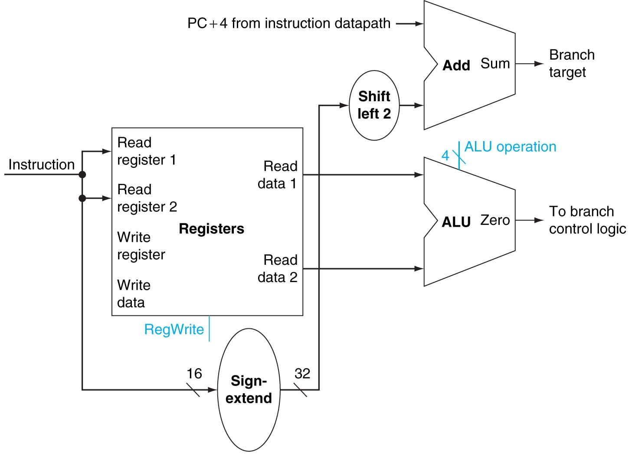
Executing Branch Operations (cont.)

Slide 5
Executing Jump Operations
Jump operation involves:
replace the lower 28 bits of the PC with the lower 26 bits of the fetched instruction shifted left by 2 bits
Add
4
4
Jump
address
Instruction
Memory
Shift
left 2
28
PC
Read
Address
Instruction
26

Slide 6
The Main Control Unit
The control unit takes inputs and generates a write signal for state elements (memory or registers), the selector control for multiplexors, and the ALU control
The control unit uses the 6-bit opcode field to generate these control signals
MIPS regularity and simplicity means that a simple decoding process can be used to determine how to set the control lines
The datapath operates in a single clock cycle and the signals within the datapath can vary during the clock cycle

Slide 7
The Operation of the Datapath
Execution steps for R-type instructions:
The instruction is fetched from the instruction memory, and the PC is incremented
Two register values are read from the register file using bits 25:21 and 20:16 of the instruction to select the source registers
also, the main control unit computes the setting of the control lines during this step
The ALU operates on the data values read from the register file, using the function code (bits 5:0, which is the funct field, of the instruction) to generate the ALU function
The result from the ALU is written into the register file using bits 15:11 of the instruction to select the destination register

Slide 8
The Operation of the Datapath (cont.)
Execution steps for a lw instruction:
The instruction is fetched from the instruction memory, and the PC is incremented
A register value is read from the register file using bits 25:21 of the instruction to select the source register
also, the main control unit computes the setting of the control lines during this step
The ALU computes the sum of the value read from the register file and the sign-extended, lower 16 bits of the instruction
The sum from the ALU is used as the address for the data memory
The data from the memory unit is written into the register file using bits 20:16 of the instruction to select the destination register

Slide 9
The Operation of the Datapath (cont.)
Execution steps for a beq instruction:
The instruction is fetched from the instruction memory, and the PC is incremented
Two register values are read from the register file using bits 25:21 and 20:16 of the instruction to select the source registers
also, the main control unit computes the setting of the control lines during this step
The ALU performs a subtract on the data values read from the register file
The value of PC+4 is added to the sign-extended 16 bits constant of the instruction shifted left by two, the result is the branch target address
The Zero result from the ALU is used to decide which adder result to store into the PC

Slide 10
Single Cycle Disadvantages & Advantages
Uses the clock cycle inefficiently – the clock cycle must be timed to accommodate the slowest instruction
May be wasteful of area since some functional units (e.g., adders) must be duplicated since they can not be shared during a clock cycle
but
Is simple and easy to understand
Cycle 1
Cycle 2
Clk
lw
sw
Waste
Notes:
In the Single Cycle implementation, the cycle time is set to accommodate the longest instruction, the Load instruction.
Since the cycle time has to be long enough for the load instruction, it is too long for the store instruction so the last part of the cycle here is wasted.

Slide 11
How Can We Make It Faster?
Start fetching and executing the next instruction before the current one has completed
Pipelining – all modern processors are pipelined for performance
Remember the performance equation:
CPU time = CPI * CCT * IC
Under ideal conditions and with a large number of instructions, the speedup from pipelining is approximately equal to the number of pipe stages
A five stage pipeline is nearly five times faster because the CC is nearly five times faster
Notes:
In reality the time per instruction in a pipeline processor is longer than the minimum possible because 1) the pipeline stages may not be perfectly balanced and 2) pipelining involves some overhead (like pipeline stage isolation registers).

Slide 12
The Five Stages of Load Instruction
Cycle 1
Cycle 2
Cycle 3
Cycle 4
Cycle 5
lw
IFetch
Dec
Exec
Mem
WB
IFetch: Instruction Fetch and Update PC
Dec: Registers Fetch and Instruction Decode
Exec: Execute R-type; calculate memory address
Mem: Read/write the data from/to the Data Memory
WB: Write the result data into the register file
Notes:
As shown here, each of these five steps will take one clock cycle to complete.

Slide 13
A Pipelined MIPS Processor
Start the next instruction before the current one has completed
improves throughput - total amount of work done in a given time
instruction latency (execution time - time from the start of an instruction to its completion) is not reduced
clock cycle (pipeline stage time) is limited by the slowest stage
for some stages don’t need the whole clock cycle (e.g., WB)
for some instructions, some stages are wasted cycles (i.e., nothing is done during that cycle for that instruction)

Slide 14
A Pipelined MIPS Processor (cont.)
Cycle 1
Cycle 2
Cycle 3
Cycle 4
Cycle 5
Cycle 6
Cycle 7
Cycle 8
lw
IFetch
Dec
Exec
Mem
WB
sw
IFetch
Dec
Exec
Mem
WB
R-type
IFetch
Dec
Exec
Mem
WB

Slide 15
Single Cycle versus Pipeline
Single Cycle Implementation (CC = 800 ps):
Cycle 1
Cycle 2
Clk
lw
sw
Waste
Pipeline Implementation (CC = 200 ps):
lw
IFetch
Dec
Exec
Mem
WB
To complete an entire instruction in the pipelined case takes 1000 ps
sw
IFetch
Dec
Exec
Mem
WB
R-type
IFetch
Dec
Exec
Mem
WB
Notes:
1,000,000 adds for single cycle = 800,000,000 ps
1,000,000 adds for pipelined = 200,000,000 ps + 800 ps (fill or flush time)

Slide 16
Pipelining the MIPS
What makes it easy
all instructions are the same length (32 bits) so they can fetch in the 1st stage and decode in the 2nd stage
Some instructions can begin reading register file in 2nd stage
memory operations occur only in loads and stores and can use the execute stage to calculate memory addresses
each instruction writes at most one result (i.e., changes the machine state) and does it in the last two pipeline stages (MEM or WB)
operands must be aligned in memory so a single data transfer takes only one data memory access

Slide 17
MIPS Pipeline Datapath
IF:IFetch
ID:Dec
EX:Execute
MEM:
MemAccess
WB:
WriteBack
IF/ID
ID/EX
EX/MEM
Add
4
Shift
left 2
Add
MEM/WB
Instruction
Memory
Read Addr 1
Data
Memory
Register
File
Read
Data 1
Read Addr 2
PC
Read
Address
Read
Data
Write Addr
ALU
Address
Read
Data 2
Write Data
Write Data
Sign
Extend
16
32
System Clock
Notes:
Any info that is needed in a later pipe stage must be passed to that stage via a pipeline register (e.g., need to preserve the destination register address in the pipeline state registers)
Note two exceptions to right-to-left flow
WB that writes the result back into the register file in the middle of the datapath
Selection of the next value of the PC, one input comes from the calculated branch address from the MEM stage
Only later instructions in the pipeline can be influenced by these two REVERSE data movements.
The first one (WB to ID) leads to data hazards.
The second one (MEM to IF) leads to control hazards.
All instructions must update some state in the processor – the register file, the memory, or the PC – so separate pipeline registers are redundant to the state that is updated (not needed).
PC can be thought of as a pipeline register: the one that feeds the IF stage of the pipeline. Unlike all of the other pipeline registers, the PC is part of the visible architecture state – its content must be saved when an exception occurs (the contents of the other pipe registers are discarded).

Slide 18
Graphically Representing MIPS Pipeline
IM
(IF)
Reg
(ID)
ALU
(EX)
DM
(MEM)
Reg
(WB)

Slide 19
Why Pipeline? For Performance!
Time (clock cycles)
Once the pipeline is full, one instruction is completed every cycle, so CPI = 1
Inst 0
IM
Reg
DM
Reg
I
n
s
t
r.
O
r
d
e
r
ALU
Inst 1
IM
Reg
DM
Reg
ALU
Inst 2
IM
Reg
ALU
DM
Reg
Inst 3
IM
Reg
ALU
DM
Reg
Inst 4
IM
Reg
ALU
DM
Reg
Time to fill the pipeline

Slide 20
Can Pipelining Get Us Into Trouble?
Yes: Pipeline Hazards
structural hazards: attempt to use the same resource by two different instructions at the same time
data hazards: attempt to use data before it is ready
An instruction’s source operand(s) are produced by a prior instruction still in the pipeline
control hazards: attempt to make a decision about program control flow before the condition has been evaluated and the new PC target address calculated
branch and jump instructions
Notes:
Note that data hazards can come from R-type instructions or lw instructions
Exceptions can’t be resolved by waiting!

Slide 21
A Single Memory Would Be a Structural Hazard
Time (clock cycles)
Reading data from memory
lw
Mem
Reg
Mem
Reg
I
n
s
t
r.
O
r
d
e
r
ALU
Inst 1
Mem
Reg
Mem
Reg
ALU
Inst 2
Mem
Reg
ALU
Mem
Reg
Inst 3
Mem
Reg
ALU
Mem
Reg
Inst 4
Reading instruction from memory
Mem
Reg
ALU
Mem
Reg
Fix with separate instruction and data memories (I$ and D$)

Slide 22
How About Register File Access?
Time (clock cycles)
Fix register file access hazard by doing reads in the second half of the cycle and writes in the first half
add $s1,
IM
Reg
DM
Reg
I
n
s
t
r.
O
r
d
e
r
ALU
Inst 1
IM
Reg
DM
Reg
ALU
Inst 2
IM
Reg
ALU
DM
Reg
add $s2,$s1,
IM
Reg
ALU
DM
Reg
Notes:
Define register reads to occur in the second half of the cycle and register writes in the first half

Slide 23
Register Usage Can Cause Data Hazards
Dependencies backward in time cause hazards
add $s1,
IM
Reg
ALU
DM
Reg
sub $s4,$s1,$s5
IM
Reg
ALU
DM
Reg
and $s6,$s1,$s7
IM
Reg
ALU
DM
Reg
or $s8,$s1,$s9
IM
Reg
ALU
DM
Reg
xor $s4,$s1,$s5
IM
Reg
ALU
DM
Reg
Read before write (data hazard)
Notes:
For lecture

Slide 24
Avoiding the Data Hazard
The compiler inserts two nops (no operation instruction) before the and instruction
add $s1, $s2, $s3
nop
nop
sub $s4, $s1, $s5
and $s6, $s1, $s7
or $s8, $s1, $s9
xor $s4, $s1, $s5

Slide 25
One Way to “Fix” a Data Hazard
Can fix data hazard by waiting
add $s1,
IM
Reg
DM
Reg
I
n
s
t
r.
O
r
d
e
r
ALU
nops
nops
sub $s4,$s1,$s5
IM
Reg
DM
Reg
ALU
and $s6,$s1,$s7
IM
Reg
ALU
DM
Reg

Slide 26
Another Way to “Fix” a Data Hazard
Fix data hazards by forwarding results as soon as they are available to where they are needed
add $s1,
IM
Reg
ALU
DM
Reg
I
n
s
t
r.
O
r
d
e
r
sub $s4,$s1,$s5
IM
Reg
ALU
DM
Reg
IM
Reg
ALU
DM
Reg
and $s6,$s1,$s7
or $s8,$s1,$s9
IM
Reg
ALU
DM
Reg
xor $s4,$s1,$s5
IM
Reg
ALU
DM
Reg
Notes:
For lecture
Forwarding paths are valid only if the destination stage is later in time than the source stage.
Forwarding is harder if there are multiple results to forward per instruction or if they need to write a result early in the pipeline.
Notice that for now we are showing the forwarded data coming out of the ALU. After looking at the problem more closely, we will see that it is really supplied by the pipeline register EX/MEM or MEM/WB and will depict is as such.

Slide 27
Loads Can Cause Data Hazards
Dependencies backward in time cause hazards
lw $s1,4($s2)
IM
Reg
ALU
DM
Reg
I
n
s
t
r.
O
r
d
e
r
sub $s4,$s1,$s5
IM
Reg
ALU
DM
Reg
and $s6,$s1,$s7
IM
Reg
ALU
DM
Reg
or $s8,$s1,$s9
IM
Reg
ALU
DM
Reg
xor $s4,$s1,$s5
IM
Reg
ALU
DM
Reg
Load-use data hazard
Notes:
Note that lw is just another example of register usage (beyond ALU ops)

Slide 28
Branch Instructions Cause Control Hazards
Dependencies backward in time cause hazards
beq
IM
Reg
DM
Reg
I
n
s
t
r.
O
r
d
e
r
ALU
lw
IM
Reg
ALU
DM
Reg
Inst 3
IM
Reg
ALU
DM
Reg
Inst 4
IM
Reg
ALU
DM
Reg

